Slide 1
Legacy Program
Individual Vessel Incentives - Rewards: There is more reward
incentive to avoid bycatch during low chinook salmon abundance
Years (blue).
Think of this as having
Additional Insurance
Notes:
The downstream financial reward of having additional ITEC can be large!

Slide 2
Legacy Program
Individual Vessel Incentives - Penalties: Every vessel’s future
allocation of ITEC is at risk of being reduced if their relative
performance is poor. This penalty is greater during low salmon
abundance years (blue).
Think of this as having
reduced insurance
due to high bycatch

Slide 3
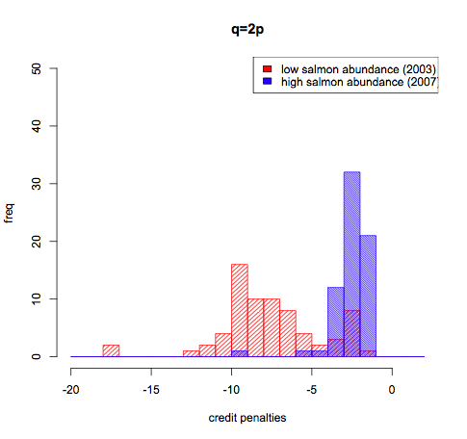
Legacy Program
Individual vessel incentives
Every vessel’s future allocation of credits is at risk of being reduced if their relative performance is poor. This penalty is greater during low salmon abundance years.
Notes:
This is a slide I sent to john to use in his ppt. It has a better format than the others. it is readable, and has a complete legend, but lacks the median which is useful. It would be better w/o q=2p.

Slide 4
Legacy Program: Hypothetical Cumulative Trading Incentives

Slide 5
Hypothetical Cumulative Incentives

